Slide 1
Working across the DTPR domain
How the proposed object oriented view of “format” can be viewed, and how it reaches back out to the rest of the DPTR informational domain

Slide 2
Session Overview
We’ll see how the format model co-exists inside the DPTR
We’ll understand how a format family is built up, and how we can generate format identifiers that fit the level of detail we require.

Slide 3
Session Overview
We’ll see how source data is included in the model, and how its inherited through the format descriptive stack
We’ll appreciate one of the underpinning strategies – conceptualising format ID as both a high level permanent assertion, and as a low level malleable assertion like AV scanning

Slide 4
Returning to the DPTR domain
Format as a discrete component in the model
Format
Carrier Medium
Software
Relationship
IO Device
Hardware

Slide 5
Returning to the DPTR domain
[Format_A] [renders in] [Software_B]
[Format_A] [is editable in] [Software_B]
[Format_A] [contains] [Aspect_A]
[Format_A] [contains] [Format_B]

Slide 6
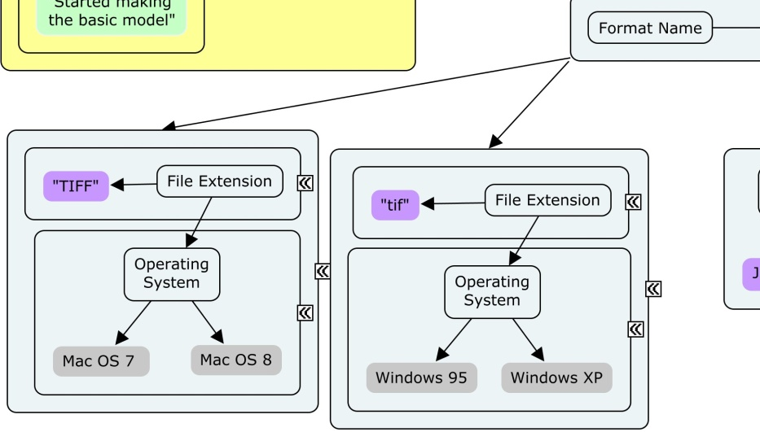
Non “top level” linkages
Noting where aspects reference software or other non-format items

Slide 7
Descending through the Format
Showing how TIF can be TIFF > 6.0 > Baseline > RGB
Showing that descent and demonstrating the use of a format identifier at each level.
Showing how the format identifier can include spec aspects and imp aspects

Slide 8
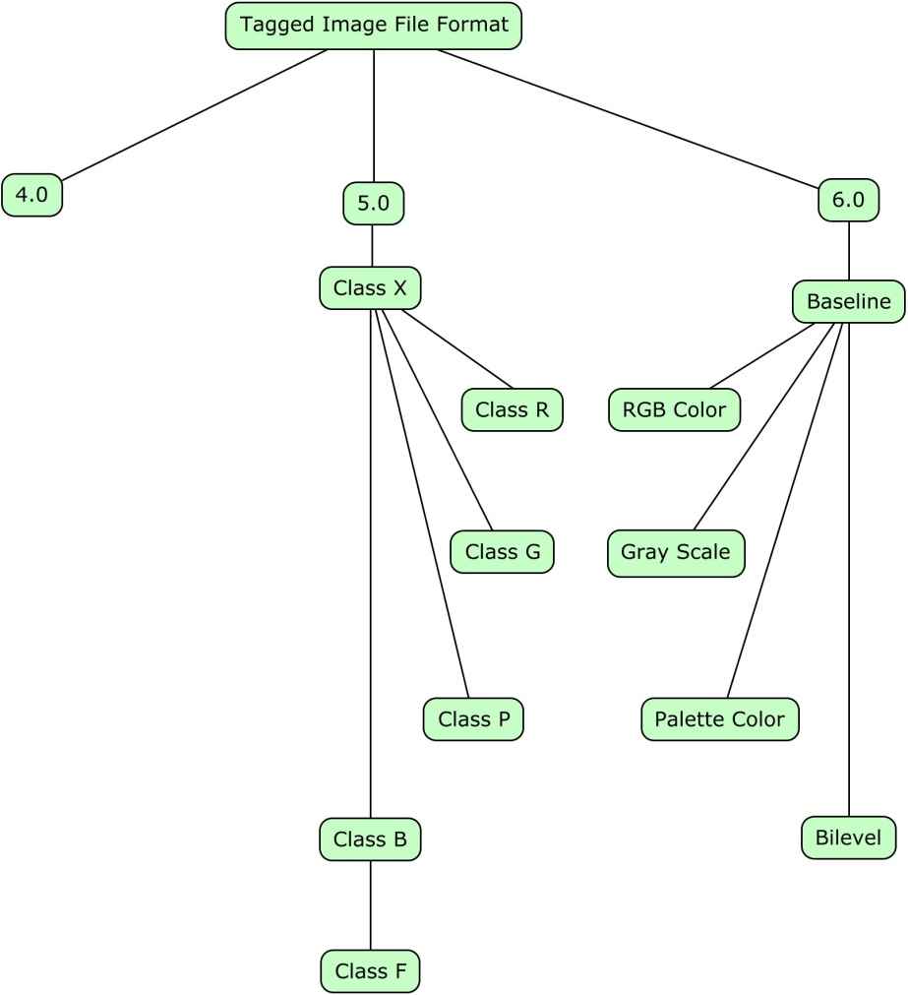
Descending through the Format(s)
ID: ZWgPmbP2wY
Everything the system know about TIFF

Slide 9
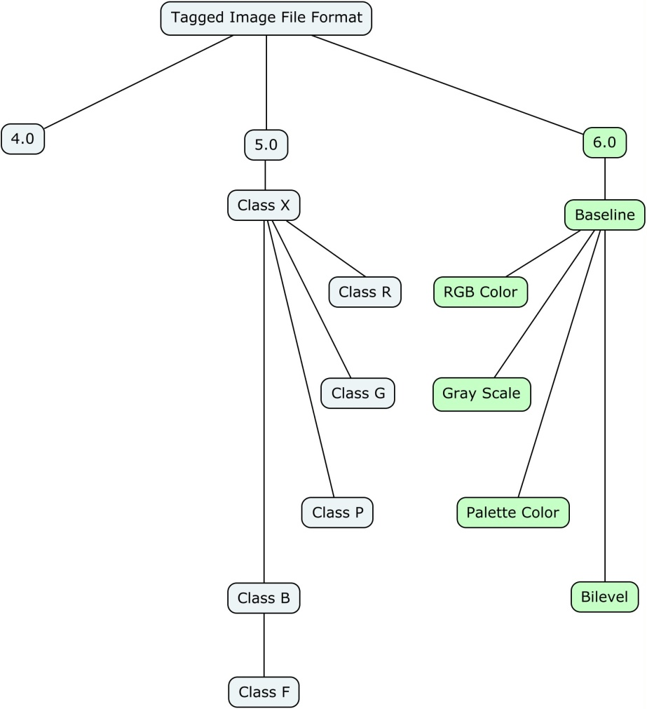
Descending through the Format(s)
ID: 5rVEoUJbSt
Everything the system know about TIFF Revision 6.0

Slide 10
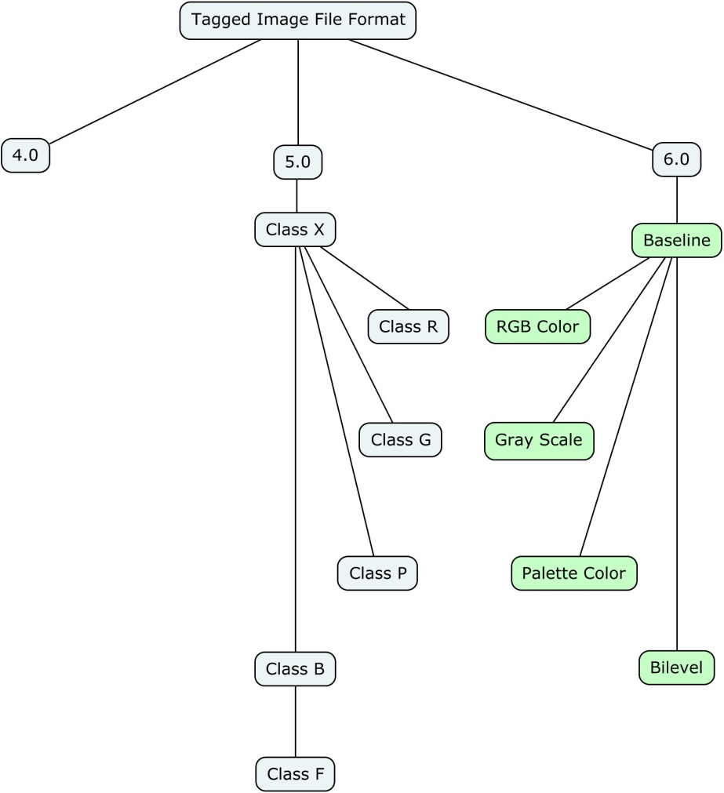
Descending through the Format(s)
ID: TTuUH5vK4t
Everything the system know about TIFF Revision 6.0 Baseline

Slide 11
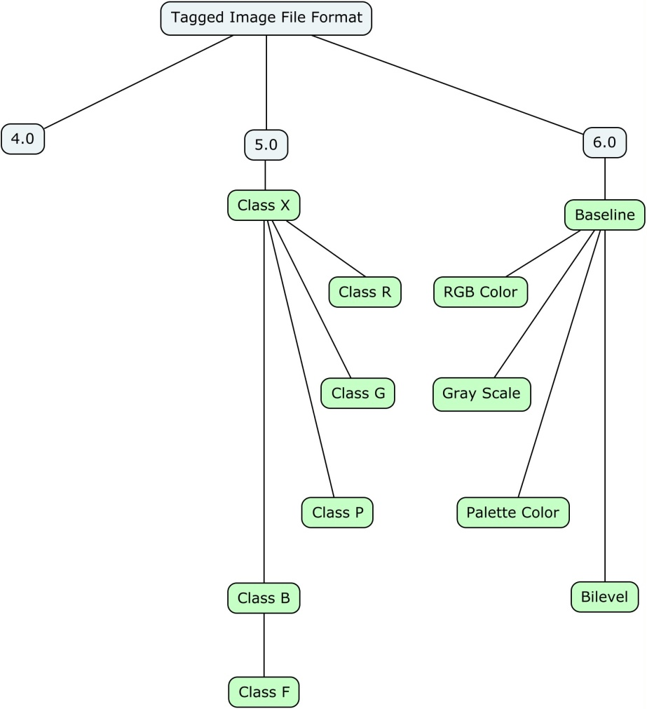
Descending through the Format(s)
ID: wym5Gb7E3K
Everything the system know about TIFF Revision 6.0 baseline, AND Revision 5.0 Class X

Slide 12
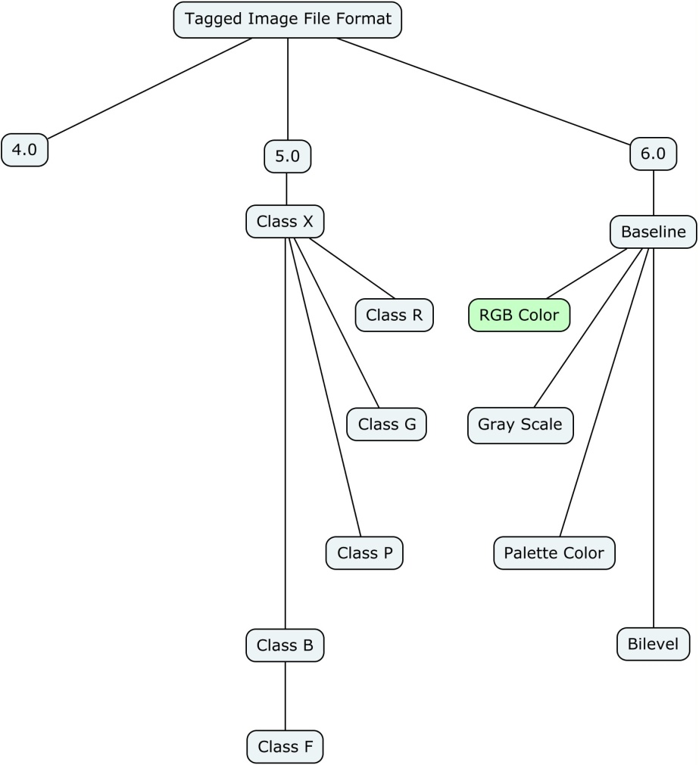
Descending through the Format(s)
ID: 8MF423Kg6n
Everything the system know about TIFF Revision 6.0 Baseline RGB Color

Slide 13
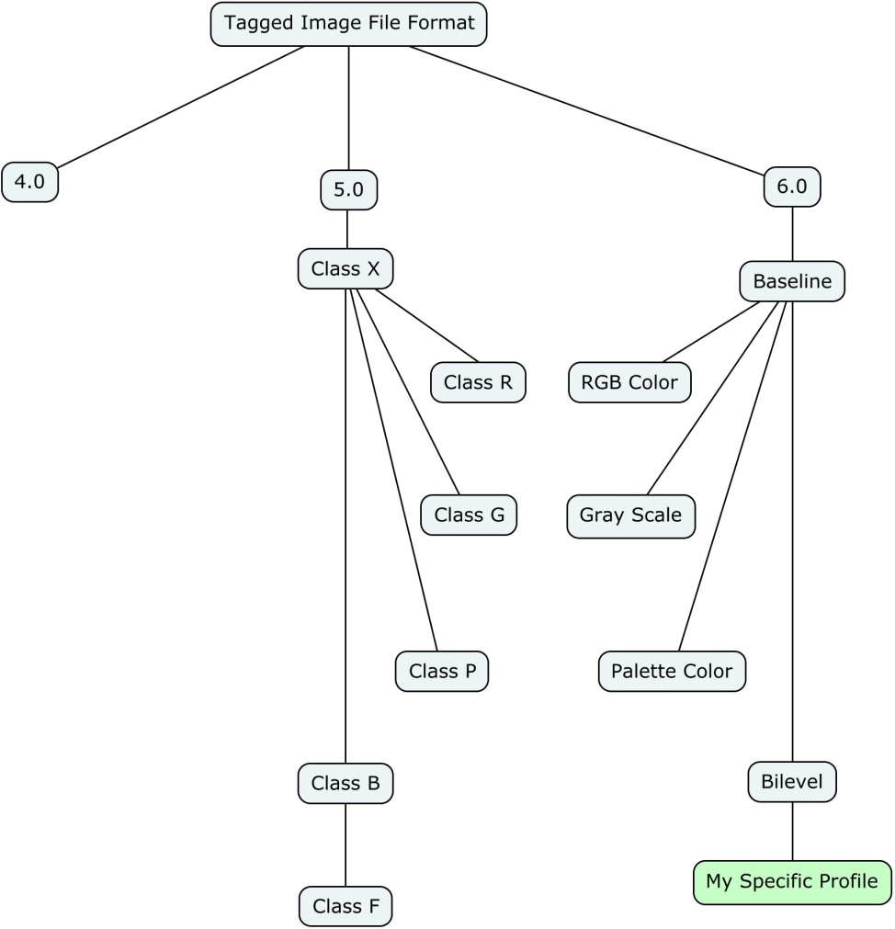
Descending through the Format(s)
ID: 1cbKXgJ3Yk
Everything the system know about TIFF Revision 6.0 Baseline RGB Color with a specifically document set of properties

Slide 14
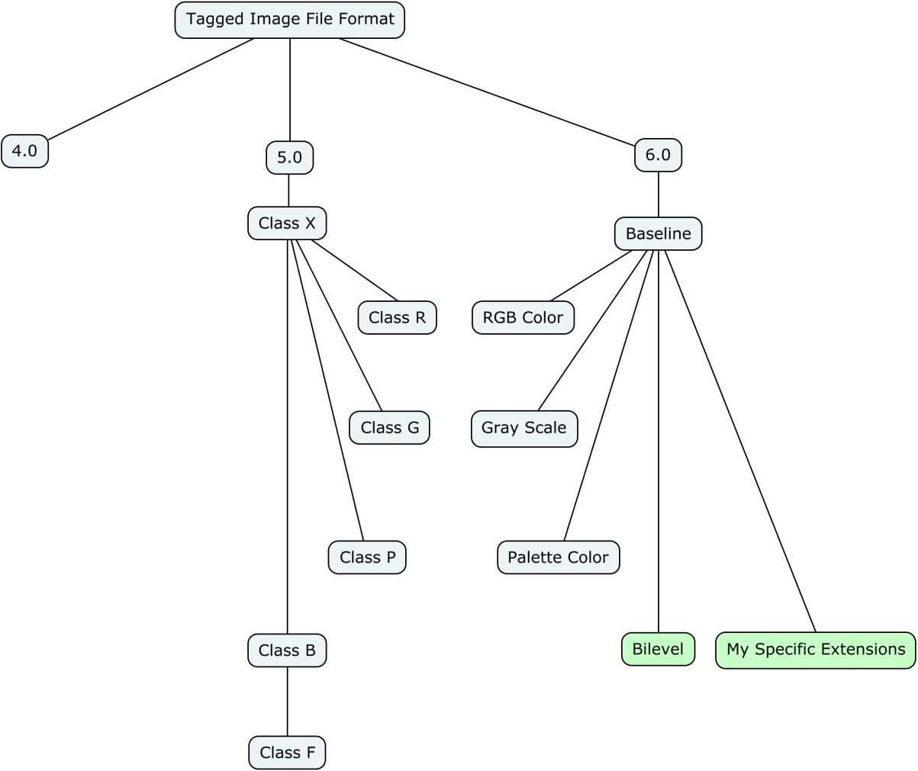
Descending through the Format(s)
ID: jvoA79fPIv
Everything the system know about TIFF Revision 6.0 Baseline Bilevel, with some extra tags from baseline

Slide 15
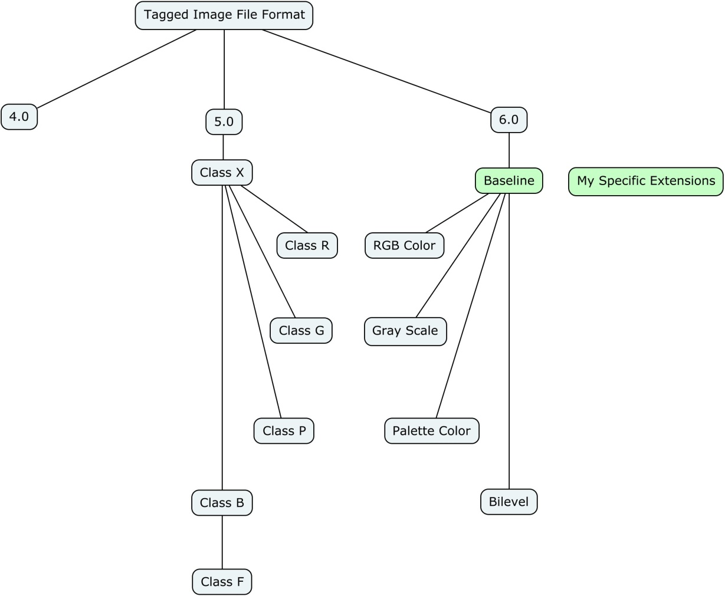
Descending through the Format(s)
ID: CEpLJKFVoJ
Everything the system know about TIFF Revision 6.0 Baseline Bilevel, with some extra tags from outside the TIFF spec (e.g exif?)

Slide 16
Discussion: Keywording the Aspects
The principle of managing a unified concept repository as Aspects.
How will we do the linking? Some are obvious (e.g. LZW is LZW) others are less so, what’s the scaled suitable method for building folksonomies/taxonomies/thesauri?

Slide 17
Discussion: Format as an AV type activity
Changing our mindset based on our current understanding of what matters about format ID
Need systems that allow the distribution of signature files as updates like AV signature files are distributed

Slide 18
Discussion: Format as an AV type activity
Need systems that understand the malleability of format assertion, and the granular usefulness of new model.
Need both concrete high order / generic identifers and very specific indentifers for uniquely important but similar format objects

Slide 19
Fin.

